Slide 1
Updating Tobacco Policy: How [CITY/COUNTY] Can Protect Youth and Improve Health
Presented by: [PRESENTER, CREDENTIALS] | Contact: [EMAIL]
[AFFILIATED ORGANIZATION(S)] | Last updated: 9.9.20
Notes:
local governments have used their authority to enact tobacco control policies to protect communities from tobacco-related harms and youth tobacco initiation

Slide 2
Overview
Data on tobacco use rates
Key proposed policy changes
Including e-cigarettes in Clean Indoor Air Laws
Adapting to Tobacco 21
Enforcement
Prevention and Cessation

Slide 3
Tobacco Use
Nationally and in [CITY OR County]

Slide 4
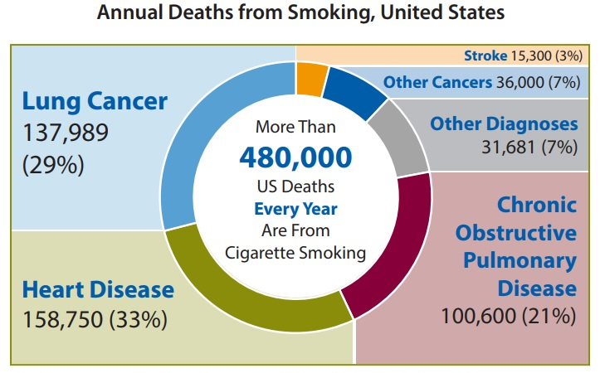
Tobacco is the #1 cause of premature death in the United States
Notes:
To start, it is important to note tobacco is the number 1 cause of premature death in the United States. Cigarette smoking is destructive to the body, causing conditions such as cancer, heart and lung disease.
Sources:
https://www.cdc.gov/tobacco/data_statistics/fact_sheets/health_effects/tobacco_related_mortality/index.htm
https://www.cdc.gov/tobacco/infographics/health-effects/index.htm

Slide 5
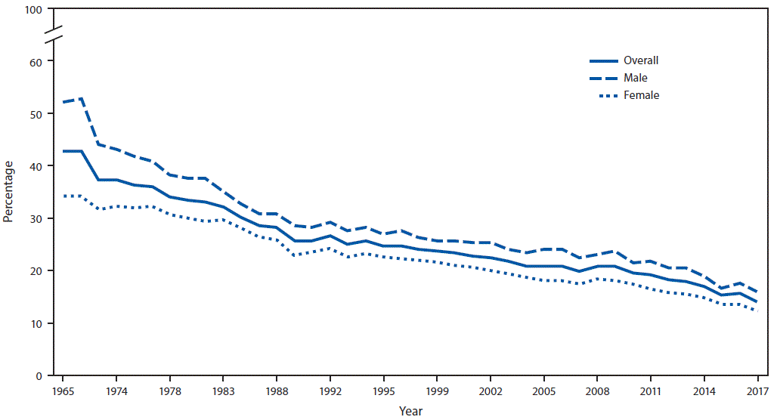
Overall, Tobacco use is Decreasing
Notes:
CDC data for US adults
https://www.cdc.gov/mmwr/volumes/67/wr/mm6744a2.htm

Slide 6
NYTS (National Youth Tobacco Survey) Prevalence (% of HS)
Notes:
Cigarette use is also decreasing for youth, but e-cigarette use has substantially increased in the past few years
https://www.cdc.gov/tobacco/data_statistics/surveys/nyts/index.htm

Slide 7
MiPHY (Michigan Profile for Healthy Youth)
Voluntary survey completed by 7, 9, and 11th grade students in Michigan
Database: https://mdoe.state.mi.us/schoolhealthsurveys/ExternalReports/CountyReportGeneration.aspx
Notes:
MiPHY can provide local information to know where [CITY OR COUNTY] stands in relation to the rest of Michigan

Slide 8
Percentage of [COUNTY] students who used an electronic vapor product during the past 30 days
Compared to other Counties in Michigan:
Notes:
Change graphics to be county-specific using MiPHY: https://mdoe.state.mi.us/schoolhealthsurveys/ExternalReports/CountyReportGeneration.aspx

Slide 9
Among students who used electronic vapor products in past 30 days, the percentage who usually…
Notes:
2017-2018 data
Change graphics to be county-specific using MiPHY: https://mdoe.state.mi.us/schoolhealthsurveys/ExternalReports/CountyReportGeneration.aspx

Slide 10
[Any other local level data]

Slide 11
Key policy changes
Including e-cigarettes in Clean Indoor Air Laws
Adapting to Tobacco 21

Slide 12
Including E-cigarettes in Clean Indoor Air Laws

Slide 13
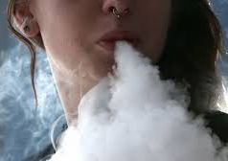
E-Cigarette Use Create Airborne Hazards
E-cigarette aerosol is not just “water vapor”
E-cigarettes emit less chemicals than cigarettes and at lower concentrations
Still a concern since the compounds cause harm
Bystanders should not be involuntarily exposed to secondhand emissions
Notes:
Sources:
Secondhand Exposure to Vapors From Electronic Cigarettes
https://doi.org/10.1093/ntr/ntt203
Particulate Matter from Electronic Cigarettes and Conventional Cigarettes: a Systematic Review and Observational Study
https://doi.org/10.1007/s40572-015-0072-x
Use of electronic cigarettes (e-cigarettes) impairs indoor air quality and increases FeNO levels of e-cigarette consumers
https://doi.org/10.1016/j.ijheh.2013.11.003
Cigarettes vs. e-cigarettes: Passive exposure at home measured by means of airborne marker and biomarkers
https://doi.org/10.1016/j.envres.2014.09.005

Slide 14
Chemicals Identified in E-Cigarette Aerosol
Aerosolized nicotine
Fine particles (PM2.5)
“Ultrafine particles formed from supersaturated 1,2- propanediol vapor”
Other chemicals and toxins including:
Formaldehyde*
Acetaldehyde*
Acrolein
Volatile organic compounds
Nickel*
Lead*
*Known to cause cancer
Notes:
Particulate Matter from Electronic Cigarettes and Conventional Cigarettes: a Systematic Review and Observational Study
https://doi.org/10.1007/s40572-015-0072-x
Use of electronic cigarettes (e-cigarettes) impairs indoor air quality and increases FeNO levels of e-cigarette consumers
https://doi.org/10.1016/j.ijheh.2013.11.003
Campaign for Tobacco-Free Kids. 2020. “Electronic Cigarettes Should Be Included in Smoke-Free Laws”. https://www.tobaccofreekids.org/assets/factsheets/0387.pdf
Impact of Electronic Cigarettes on the Cardiovascular System
https://doi.org/10.1161/JAHA.117.006353

Slide 15
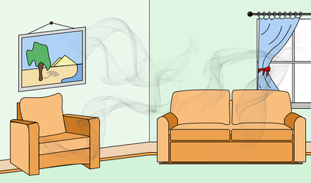
Secondhand Aerosol
Vaping also effects non-users, especially indoors
“Non-smokers passively exposed to e-cigarettes absorb nicotine”
Biomarkers also show non-users had chemicals besides nicotine (cotinine) in their body after exposure
E-cigarettes can also be a source of thirdhand exposure to nicotine via surfaces
Can contribute to secondhand exposure as well due to desorption
It is unclear what the effects of such exposure is, especially among vulnerable groups like children, pregnant women, and individuals with cardiovascular disease
Notes:
A team of researchers from Spain, Ballbè et al found “non-smokers passively exposed to e-cigarettes absorb nicotine”
Sources:
Cigarettes vs. e-cigarettes: Passive exposure at home measured by means of airborne marker and biomarkers
https://doi.org/10.1016/j.envres.2014.09.005
Secondhand Exposure to Vapors From Electronic Cigarettes
https://doi.org/10.1093/ntr/ntt203
Electronic Cigarettes Are a Source of Thirdhand Exposure to Nicotine
https://doi.org/10.1093/ntr/ntu152
Impact of Electronic Cigarettes on the Cardiovascular System
https://doi.org/10.1161/JAHA.117.006353

Slide 16
More Research Is Needed
While other chemicals, such as propylene glycol and vegetable glycerin, are considered “safe”, it is unclear…
If prolonged exposure to aerosol will have health effects
If physicochemical changes occur after release into ambient air which creates hazards (as it does for tobacco smoke)
If compounds unique to e-cigarettes which are not in other tobacco products effect health
Notes:
Sources:
Secondhand Exposure to Vapors From Electronic Cigarettes
https://doi.org/10.1093/ntr/ntt203
Particulate Matter from Electronic Cigarettes and Conventional Cigarettes: a Systematic Review and Observational Study
https://doi.org/10.1007/s40572-015-0072-x
Use of electronic cigarettes (e-cigarettes) impairs indoor air quality and increases FeNO levels of e-cigarette consumers
https://doi.org/10.1016/j.ijheh.2013.11.003
Cigarettes vs. e-cigarettes: Passive exposure at home measured by means of airborne marker and biomarkers
https://doi.org/10.1016/j.envres.2014.09.005

Slide 17
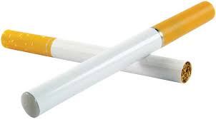
Ensuring Success for Smoke-Free Laws
Including e-cigarettes and other vapor products:
Reduces burden on businesses to distinguish between products
For example, e-cigarettes and cigarettes can look very similar
Creates an environment where cessation is more likely, and initiation is less likely
Does not infringe on the rights of legal users of vapor products
Vaping can still be done outside (with the exception of school property or 100 ft within school property)
Notes:
Campaign for Tobacco-Free Kids. 2020. “Electronic Cigarettes Should Be Included in Smoke-Free Laws”. https://www.tobaccofreekids.org/assets/factsheets/0387.pdf

Slide 18
“Diverse actions, modeled after evidence-based tobacco control strategies, can be taken at the state, local, tribal, and territorial levels to address e-cigarette use among youth and young adults, including incorporating e-cigarettes into smoke-free policies…”
Vivek H. Murthy, M.D., M.B.A.
Former U.S. Surgeon General
2016
Notes:
U.S. Department of Health and Human Services. E-Cigarette Use Among Youth and Young Adults. A Report of the Surgeon General. Atlanta, GA: U.S. Department of Health and Human Services, Centers for Disease Control and Prevention, National Center for Chronic Disease Prevention and Health Promotion, Office on Smoking and Health, 2016. https://e-cigarettes.surgeongeneral.gov/documents/2016_SGR_Full_Report_non-508.pdf

Slide 19
Other Organizations Also Support Including E-Cigarettes in Smoke-Free Policies
“[The AHA] also supports including e-cigarettes in smoke-free air laws and prohibiting the sales of e-cigarettes to youth.”
“E-cigarettes should be subject to the same restrictions regarding public use as combustible tobacco products, and e-cigarettes should not be used in smoke-free areas.”
“ENDS users should be legally requested not to use ENDS indoors, especially where smoking is banned until exhaled vapour is proven to be not harmful to bystanders and reasonable evidence exists that smokefree policy enforcement is not undermined”
Notes:
*These are just a few organizations who specifically stated they supported including e-cigarettes in smoke-free laws
U.S. Department of Health and Human Services. E-Cigarette Use Among Youth and Young Adults. A Report of the Surgeon General. Atlanta, GA: U.S. Department of Health and Human Services, Centers for Disease Control and Prevention, National Center for Chronic Disease Prevention and Health Promotion, Office on Smoking and Health, 2016. https://e-cigarettes.surgeongeneral.gov/documents/2016_SGR_Full_Report_non-508.pdf

Slide 20
E-Cigarettes Should be Included in All Tobacco Policies
E-cigarettes are not risk-free
Compounds within vapor products can cause irritation and pose long-term health risks
Nicotine concentrations vary but sometimes have been found to be greater than manufacturers advertise
Long-term effects are not known yet in some products
There is mixed evidence on whether e-cigarettes are an effective cessation aid
Dual use with cigarettes rather than switching completely negates potential health benefits
A RCT study in the UK showed e-cigarettes were more effective than NRT
Some studies show e-cigarettes make cessation less likely
Comprehensive policies go beyond just e-cigarettes and are needed to effectively regulate emerging products and close loopholes
Notes:
Sources:
“E-Cigarettes: Use, Effects on Smoking, Risks, and Policy Implications”
https://doi.org/10.1146/annurev-publhealth-040617-013757
“E-Cigarettes and Cardiovascular Disease Risk: Evaluation of Evidence, Policy Implications, and Recommendations”
https://doi.org/10.1007/s12170-016-0505-6
U.S. Preventive Services Task Force, Behavioral and Pharmacotherapy Interventions for Tobacco Smoking Cessation in Adults, Including Pregnant Women: U.S. Preventive Services Task Force Recommendation Statement, 163 Annals of Internal Medicine (2015), http://www.uspreventiveservicestaskforce.org/Page/Document/UpdateSummaryFinal/tobacco-use-in-adults-and-pregnant-women-counseling-and-interventions1.
Brian King, et al., Awareness and Ever Use of Electronic Cigarettes Among U.S. Adults, 2010-2011, 15 Nicotine & Tobacco Research 1623 (2013). See also, Brian King et al., Trends in Awareness and Use of Electronic Cigarettes among U.S. Adults, 2010-2013, 17 Nicotine & Tobacco Research 219 (2014).
Samane Zare et al., A systematic review of consumer preference for e-cigarette attributes: Flavor, nicotine strength, and type, 13 PLoS One. 1 (2018) Mar 15; https://doi.org/10.1371/journal.pone.0194145
CDC, QuickStats: Cigarette Smoking Status Among Current Adult E-cigarette Users, by Age Group — National Health Interview Survey, United States, 2015, 65 MMWR 1177 (October 28, 2016), https://www.cdc.gov/mmwr/volumes/65/wr/mm6542a7.htm. See also CDC, About Electronic Cigarettes (E-Cigarettes), https://www.cdc.gov/tobacco/basic_information/e-cigarettes/about-e-cigarettes.html#who-is-using-e-cigarettes

Slide 21
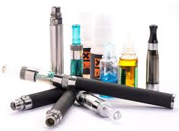
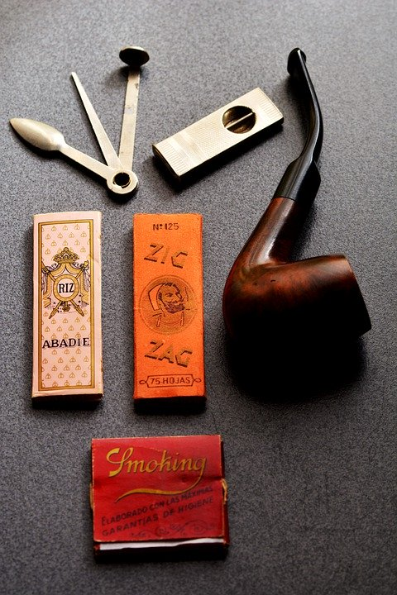
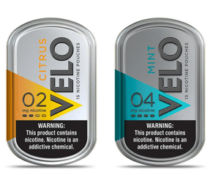
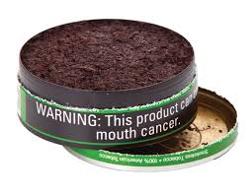
Covering Tobacco Comprehensively
Conventional Tobacco Products
Tobacco Product Paraphernalia
Vapor Products
Alternative Nicotine Products
Notes:
Conventional tobacco products (cigarettes, cigars, chewing tobacco, etc.)
Tobacco product paraphernalia (pipes, rolling paper, electronic devices, etc.)
Vapor products (e-cigarettes, vape juice, reusable devices, disposable products, etc.)
Alternative nicotine products
▪ Some manufactured by tobacco companies, some manufactured by pharmaceutical companies
▪ All do not contain tobacco, only nicotine
• Advertised as tobacco-free, but regulated as tobacco products
• Slower delivery of nicotine than e-cigarettes
▪ Very similar to smokeless tobacco
▪ Came from snus (Swedish)
▪ Add flavors to create taste (otherwise there is no flavor)
▪ Currently a small part of the market, but growing
▪ No premarket approval
Definitions in SFELP model policy for reference:
2-3 Tobacco Product – Shall mean any product that is made from or derived from tobacco, and is intended for human consumption or is likely to be consumed, whether smoked, heated, chewed, absorbed, dissolved, inhaled or ingested by any other means, including, but not limited to, a cigarette, a cigar, pipe tobacco, chewing tobacco, snuff, snus, or any other smokeless tobacco. The term also includes vapor products and alternative tobacco products. The term also includes tobacco product paraphernalia, whether or not they contain nicotine. Tobacco product does not include drugs, devices, or combination products authorized for sale by the U.S. Food and Drug Administration, as those terms are defined in the Federal Food, Drug and Cosmetic Act.
2-4 Tobacco Product Paraphernalia – Shall mean any product that is used to assist in chewing, smoking, absorbing, dissolving, inhaling, or any other consumption of tobacco to include, but not limited to pipes, rolling papers, and electronic smoking devices.
2-5 Vapor Product – Shall mean a noncombustible product that employs a heating element, power source, electronic circuit, or other electronic, chemical, or mechanical means, regardless of shape or size, that can be used to produce vapor from nicotine or any other substance, and the use or inhalation of which simulates smoking. Vapor product includes an electronic cigarette, electronic cigar, electronic cigarillo, electronic pipe, or similar product or device and a vapor cartridge or other container of nicotine or other substance in a solution or other form that is intended to be used with or in an electronic cigarette, electronic cigar, electronic cigarillo, electronic pipe, or similar product or device. Vapor product does not include a product regulated as a drug or device by the United States Food and Drug Administration under 21 USC 351 to 360fff-7.
2-6 Alternative Nicotine Product – Shall mean a noncombustible product containing nicotine that is intended for human consumption, whether chewed, absorbed, dissolved, or ingested by any other means. Alternative nicotine product does not include a tobacco product, a vapor product, food, or a product regulated as a drug or device by the United States Food and Drug Administration under 21 USC 351 to 360fff-7.

Slide 22
Aligning with State Law
Including vapor products as defined by the state will move [CITY OR COUNTY] toward comprehensive policy at the state level
Senate Bill 106
Passed September 2, 2019
Prohibits furnishing youth with tobacco products, including vapor products
Specific and inclusive definition for tobacco products as including vapor products
Notes:
Vapor products are e-cigarettes as well as other products

Slide 23
Adapting to Tobacco 21

Slide 24
What are Tobacco 21 laws?
Limits minimum age of sale of tobacco products to 21 or older
Could include minimum purchase age
Can change who enforces and who is the enforcement target of such laws
Notes:
Tobacco 21 (T21) policies aim to reduce youth access to tobacco products (including cigarettes, e-cigarettes and any other tobacco products) as well as tobacco paraphernalia by restricting sales to people aged 21 or over. There is some debate over whether T21 encompasses laws that change the minimum age of purchase. T21 policies can also change who enforces and who is the enforcement target of such laws

Slide 25
Federal: Tobacco 21
Passed in late December 2019
Includes all nicotine and tobacco products
Nation-wide, no longer patchwork policy
Effectiveness depends on states and localities
Notes:
Means that those under 21 can no longer drive to a nearby town or state to purchase tobacco products.
“As of December 20, 2019, the federal age to purchase all tobacco and nicotine products is 21 years old. This means that it is now a violation of federal law for any retailer to sell any nicotine or tobacco products to anyone under the age of 21. The US Food and Drug Administration (FDA) is tasked with enforcing the law.”
https://www.aap.org/en-us/advocacy-and-policy/aap-health-initiatives/Richmond-Center/Pages/Tobacco-21.aspx
https://countertobacco.org/policy/tobacco-21/
https://tobacco21.org/federal-tobacco-21-faq/

Slide 26
State Action
Senate Bills 781-786
(currently being considered)
Among other initiatives, this set of bills proposes measures which will increase compliance with the new federal minimum age of sale
Aligns Michigan law with the new federal law and emphasizes need to comply
Similar measures at the local level can improve compliance as well
Notes:
https://tobacco21.org/federal-tobacco-21-faq/

Slide 27
Early evidence on Tobacco 21
In 2015 the IOM found T21 was highly likely to reduce smoking initiation
Decreased initiation expected to be concentrated among high school students (age 14-18)
Notes:
Institute of Medicine found T21 was highly likely to reduce smoking initiation, they predicted such effects would be conservatively, a 10% drop. This decreased initiation was expected to be concentrated among high school students (age 14-18) who would be cut off from social sources of legal cigarettes. Essentially legal cigarette purchasers would no longer be in the same social circles as these students. More research is being produced all the time, but there are many gaps in what we know about T21 that need to be filled as more and more laws are passed.

Slide 28
Data supports Tobacco 21 policy
Nicotine affects youth brain development
Many tobacco users started before age 18
Distancing likelihood of social connection of legal age
Modeling data suggests significant drop in adolescent use
Notes:
Since the IOM report even more studies have shown why it is important to increase the age of sale for all tobacco to 21
Unique, long-term effects of nicotine on adolescent brain
Pharmacol Biochem Behav. 2020 Jul 29;173010. Online ahead of print.
Frances M Leslie
https://www.sciencedirect.com/science/article/pii/S0091305720302185
Delay initiation and reduce tobacco use
https://www.aap.org/en-us/advocacy-and-policy/aap-health-initiatives/Richmond-Center/Pages/Tobacco-21.aspx
https://countertobacco.org/policy/tobacco-21/
https://truthinitiative.org/research-resources/tobacco-prevention-efforts/where-we-stand-raising-tobacco-age-21
2018 SG Report

Slide 29
Evaluation Findings for T21 Policies
“Evaluation of California’s ‘Tobacco 21’ law”
“Do Local Tobacco-21 Laws Reduce Smoking Among 18 to 20 Year-Olds?”
After 7 months “98.6% of retailers were aware of the law and 60.6% supported the law”
Youth (under 18) decoy sales decreased from 10.3% to 5.7%
Very high awareness among young people across demographic groups
Yes, local T21 policies result in reduced smoking
“approximately 3.1 percentage point reduction in 18- to 20-year-olds’ likelihoods of smoking”
Notes:
Also it has been noted retailers comply with other youth access interventions
Sources:
“Evaluation of California’s ‘Tobacco 21’ law”
http://dx.doi.org/10.1136/tobaccocontrol-2017-054088
Do Local Tobacco-21 Laws Reduce Smoking Among 18 to 20 Year-Olds?
https://doi.org/10.1093/ntr/ntz123
Use of tobacco retail permitting to reduce youth access and exposure to tobacco in Santa Clara County, California”
https://doi.org/10.1016/j.ypmed.2014.01.023

Slide 30
Enforcement
Decriminalization and Working with the Community

Slide 31
Federal and State: Sales to Minors in the Past Year
FDA Compliance Check Inspections
Violation rate: 18% (out of 1423)
258 sold to minors
2019 Synar Report
Violation rate: 9.9% (out of 353)
35 sold to minors
33 sold cigarettes
1 cigar, 1 smokeless tobacco sale
No ENDS reported as sold to minors
Notes:
https://www.accessdata.fda.gov/scripts/oce/inspections/oce_insp_searching.cfm
These are the violation rates in Michigan showing that there is an opportunity to reduce sales to children further. Please update before using.
In some cities violations much higher than others, Dearborn had 40% failure rate.

Slide 32
[Local Data on Violations/Compliance]

Slide 33
It cannot be expected that enacting a law, no matter how strong, will have any impact on adolescent smoking in the absence of effective enforcement.
From “Which Interventions Against the Sale of Tobacco to Minors Can Be Expected to Reduce Smoking?”
Reducing youth tobacco use requires enforcement change in addition to policy change
Notes:
Which interventions against the sale of tobacco to minors can be expected to reduce smoking?”
http://dx.doi.org/10.1136/tobaccocontrol-2011-050145

Slide 34
Improving Enforcement
Effective: high level of compliance needed to deliver health benefits
Comprehensive: cover all products, license all premises and events
Civil: limit enforcement by police to avoid exacerbating inequalities
Tobacco laws require an effective, comprehensive and civil enforcement and compliance regime
Notes:
A University of Michigan project found T21 laws require an effective, comprehensive and civil enforcement and compliance regime to function properly.
By effective we mean the policy needs to be followed by all tobacco retailers. As the wellspring of tobacco products in their communities retailers must face incentives to comply with the law that align with public health objectives. A system must be in put in place such that fines inflicted on a retailer or clerk are not the cost of doing business when selling tobacco products to under aged customers, but rather act as measures to actually change retailer practices. Comprehensive policies must cover all products and paraphernalia, all retailers be they temporary or permanent and all events where tobacco products or paraphernalia are sold. Civil refers to limiting enforcement by the police and instead relying on food inspections or sanitarians to conduct inspections as well as taking the punishment for underage sales from the criminal to the civil realm. This means doing away with prohibitions on youth tobacco purchase use and possession.
[Cite IHPI policy sprint and related paper]

Slide 35
Decriminalization of Youth Access to Tobacco
For health advocates, a key feature of implementation is the shift from criminal penalties on minors to civil punishment for retailers
T21 policy is seen by advocates as an investment in the future of local youth by reducing access to tobacco and removing criminal charges associated with tobacco possession
Notes:
Also from the University of Michigan project

Slide 36
Why Focus on Decriminalization?
Purchase, use, and/or possession (PUP) laws can be unfair
Punishment varies (Fines, mandatory education, restrictions on driving, community service)
Youth of color more likely to be targeted, could lead to disastrous consequences
Examples: bodily harm, mental distress, and lost economic and educational opportunities
Elijah Tufono
Notes:
Unfortunately, there was an incident earlier this year (April 2020) in California involving the 14-year-old boy pictured here, Elijah, where a police officer “forcibly detained” him over possession of a cigar. Elijah and his family are now speaking out about this incident It is important to be mindful that these situations happen and could be prevented.
Additional info:
Multiple violations often invoke escalating penalties, including fines, mandatory education, restrictions on driving, and community service
Enforcement varies across communities: most happens at the local level and is often unfunded
Collateral consequences can include bodily harm, mental distress, and lost economic and educational opportunities
People of color are disproportionately affected
Evidence of the impact of PUP laws on youth tobacco use is mixed
Some studies have found evidence that it creates a deterrent effect among youth
Other studies have questioned the effectiveness, especially within communities of color from a health equity focus
Sources:
https://www.dailymail.co.uk/news/article-8267635/Shocking-video-shows-California-cop-slamming-14-year-old-boys-face-body-pavement.html
https://www.nydailynews.com/news/national/ny-video-shows-cop-punching-fourteen-year-old-pinning-him-to-ground-20200429-ortcockoxbetferemsraysn5zi-story.html
4. Tworek, Cindy, Gary Giovino, K. Michael Cummings, Andrew Hyland and Frank J. Chaloupka. 2011. Youth Access Tobacco Possession, Use and Purchase Laws: Measures of State and Local Enforcement. ImpacTeen Research Paper No. 41. Chicago: University of Illinois at Chicago.
5. IOM. 2015. Health Implications of Raising the Minimum Age for Purchasing Tobacco Products. March. http://www.nationalacademies.org/hmd/Activities/PublicHealth/TobaccoMinimumAge.aspx
6. Jason LA, Pokorny SB, Schoeny ME. Evaluating the effects of enforcements and fines on youth smoking. Critical Public Health. 2003 Mar 1;13(1):33-45.
7. Jason LA, Pokorny SB, Adams M. A randomized trial evaluating tobacco possession-use-purchase laws in the USA. Social Science & Medicine. 2008 Dec 1;67(11):1700-7.
8. Pokorny SB, Adams M, Jason L. Randomized Trial Evaluating Tobacco Possession-Use-Purchase Laws in the USA. Social science & medicine (1982). 2008 Dec;67(11):1700.
9. Jason LA, Pokorny SB, Adams M, Topliff A, Harris C, Hunt Y. Youth tobacco access and possession policy interventions: Effects on observed and perceived tobacco use. American Journal on Addictions. 2009 Aug 10;18(5):367-74.
10. Gottlieb NH, Loukas A, Corrao M, McAlister A, Snell C, Huang PP. Minors’ tobacco possession law violations and intentions to smoke: Implications for tobacco control. Tobacco control. 2004 Sep 1;13(3):237-43.
11. Ross H, Chaloupka FJ. The effect of cigarette prices on youth smoking. Health economics. 2003 Mar;12(3):217-30.
12. Tworek C, Yamaguchi R, Kloska DD, Emery S, Barker DC, Giovino GA, O’Malley PM, Chaloupka FJ. State-level tobacco control policies and youth smoking cessation measures. Health Policy. 2010 Oct 1;97(2-3):136-44.
13. Tworek, C, Giovino G, Cummings KM, Hyland A, Chaloupka FJ. 2011. Youth Access Tobacco Possession, Use and Purchase Laws: Measures of State and Local Enforcement. ImpacTeen Research Paper No. 41. Chicago: University of Illinois at Chicago. December. https://tobacconomics.org/research/youth-access-tobacco-possession-use-and-purchase-laws-measures-of-state-and-local-enforcement/
14. Naya Family Center. 2017. A Policy to Increase the Minimum Legal Sales Age for Tobacco and Nicotine Products from 18 to 21: Health Equity Implications. T21 Policy Health Equity Impact Assessment Technical Report. June. https://multco.us/file/64396/download
The Merchants, Not the Customers: Resisting the Alcohol and Tobacco Industries’ Strategy to Blame Young People for Illegal Alcohol and Tobacco Sales
https://doi.org/10.2307/3342619

Slide 37
Potential benefits of passing youth access policy must be weighed against the potential damage to young people and communities arising from arbitrary or unjust criminal enforcement of the law
Putting the responsibility of compliance on retailers rather than youth or clerks can improve compliance and avoid detrimental effects on vulnerable persons
Notes:
The Merchants, Not the Customers: Resisting the Alcohol and Tobacco Industries’ Strategy to Blame Young People for Illegal Alcohol and Tobacco Sales
https://doi.org/10.2307/3342619

Slide 38
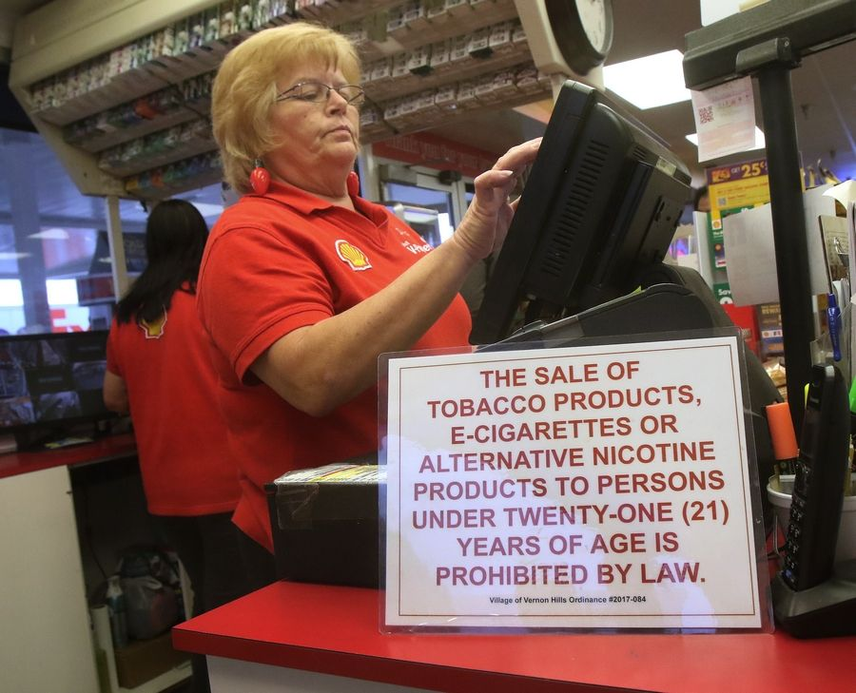
Civil Fines are Effective
Fines for retailers selling to youth is more effective than educational methods for reducing sales to youth
In Chicago, illegal sales were decreased substantially (from 86% to 42% at least) by increasing enforcement combined with civil penalties
Licensing is also effective in addition to civil penalties, but will need to come from the state level due to preemption
Notes:
Sources:
Reducing the Illegal Sales of Cigarettes to Minors: Analysis of Alternative Enforcement Schedules
https://doi.org/10.1901/jaba.1996.29-333
The Merchants, Not the Customers: Resisting the Alcohol and Tobacco Industries’ Strategy to Blame Young People for Illegal Alcohol and Tobacco Sales
https://doi.org/10.2307/3342619
Regulating the tobacco retail environment: beyond reducing sales to minors
http://dx.doi.org/10.1136/tc.2009.031724

Slide 39
Prevention and Cessation
Educating and Engaging with the Community

Slide 40
Education Requirement Included
Educating retailers and the public is key to ensuring awareness and compliance
Reach out early and often to get input to improve implementation
Protecting and promoting public health requires local collaboration
Where possible, the process should be community-driven
Health equity can only be achieved if the needs of the community are understood and being met
Clear communication is essential between public health departments and stakeholders as well as the public

Slide 41
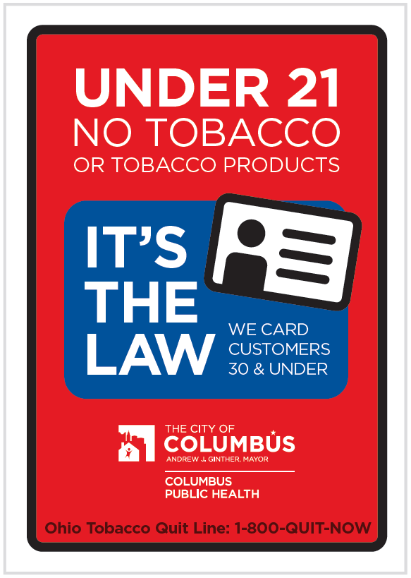
Community Engagement:
Stakeholders
Coordinated action and strong relationships among:
Enacting bodies
Implementing agencies
Enforcing agencies
Retailers
Community partners
Outreach, information, and training for retailers is an important factor in determining success
Retailer buy-in makes enforcement much easier
Notes:
https://www.columbus.gov/publichealth/programs/Tobacco-21/Download-the-Tobacco-21-Sign/
Opportunity to build relationship with retailers and keep in mind their position in communities and the vulnerability of their staff as well to penalties

Slide 42
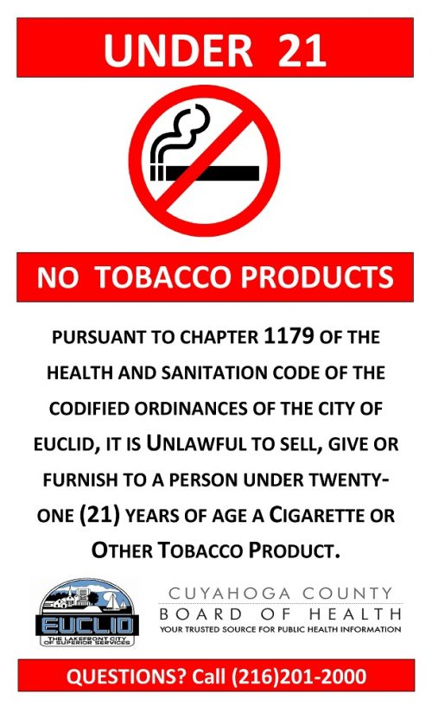
Community Engagement:
Public
Ongoing public education and messaging around the need for tobacco policy reform and consequences of youth access to tobacco products
Key activity for public health officials going forward will be to investigate complaints from members of the public against retailers suspected to be selling to underage youth
Notes:
https://www.ccbh.net/tobacco-21/

Slide 43
Evidence-Based Education
E-cigarette use may lead to uptake of cigarette smoking, but this is not confirmed
Social influences are important for tobacco, alcohol, and marijuana use, especially use by peers
Students who use or have tried e-cigarettes perceive them differently
Information of tobacco and vaping cessation resources is crucial
Notes:
Spindle, Tory R, Hiler, Marzena M, Cooke, Megan, Eissenberg, Thomas, Kendler, Kenneth S, & Dick, Danielle. (2016). Electronic Cigarette Use and Uptake of Cigarette Smoking: A Longitudinal Examination of U.S. College Students. Addictive Behaviors, 67, 66–72. Journal Article, England: Elsevier Ltd.
Michael Windle, Regine Haardörfer, Steven A. Lloyd, Bruce Foster & Carla J. Berg (2017) Social Influences on College Student Use of Tobacco Products, Alcohol, and Marijuana, Substance Use & Misuse, 52:9, 1111-1119, DOI: 10.1080/10826084.2017.1290116
Hart, E. P., Sears, C. G., Hart, J. L., & Walker, K. L. (2017). Electronic Cigarettes and Communication: An Examination of College Students' Perceptions of Safety and Use. Kentucky journal of communication, 36(1), 35–51.
Trumbo, C. W., & Harper, R. (2016). A Comparison of Students and Non-Students with Respect to Orientation Toward E-cigarettes. Journal of public health research, 5(2), 595. https://doi.org/10.4081/jphr.2016.595

Slide 44
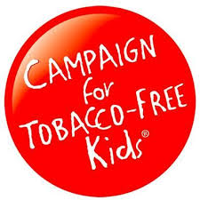
Sources for Evidence-Based Education
Information is available from the following reputable organizations:

Slide 45
Summary
Including e-cigarettes in smoke-free policies will:
Ensure safe, clean indoor air
Increase success of the existing policy
Create a comprehensive tobacco policy
Adapting to Tobacco 21 will:
Protect youth and future health
Improved enforcement and education will:
Increase compliance and success of the passed policy

Slide 46
This is an opportunity to work with our community to identify needs and a comprehensive approach to youth tobacco use
Support passage of a “Regulation to Prohibit the Sale of Tobacco Products to Individuals Under 21 Years of Age, and to Prohibit the Use of Tobacco Products in Smoke-Free Places” as a step toward better community health

Slide 47
Local Policies and Opportunities
Current action:
Include e-cigarettes and other products
Adapt to Tobacco 21
With accompanying enforcement and prevention changes
Further action:
Ordinances and zoning as legislative/regulatory tools
Point-of-sale advertising, marketing restrictions
Zoning laws to not allow retailers within a certain distance of schools
Notes:
https://countertobacco.org/resources-tools/evidence-summaries/stores-near-schools/

Slide 48
Questions?

Slide 49
Supplemental Materials

Slide 50
SFELP Can Help!
SFELP has created:
A model policy
Educational materials (decision makers and community)
Reach out for help:
Finding resources
Reviewing policy
Creating written materials (one pager, testimony)

Slide 51
Enforcement & Compliance: Federal
Federal requirements for MI to conduct compliance checks:
As contractor for the FDA under the Tobacco Control Act of 2009
To SAMHSA in exchange for block grant funding (Synar program)
Oversight by State department working with PIHPs using a Master Retailer List (every 3 years this list is checked to ensure all retailers are covered)
Differences:
FDA checks cover e-cigarettes and some novel products while Synar (which was enacted nearly 30 years ago) does not necessarily (some states do cover these products)
FDA-issued penalties are focused on premises, not clerks
Synar requires statistical sampling of retailers, FDA does not
Notes:
Background/context for federal vs. Synar compliance checks

Slide 52
Other Parts of the Model Policy
In addition to raising the minimum age the proposed policy also specifies:
Signage requirements
Near point of sale a sign must be posted stating “NO PERSON UNDER THE AGE OF 21 MAY BE SOLD TOBACCO PRODUCTS, INCLUDING VAPOR PRODUCTS.”
[name] County shall provide this notice to ensure consistency across retailers as well as compliance
Identification requirements
Anyone appearing 30 years or younger must show ID
Internet sales must be picked up at a tobacco retailer so age can be confirmed
Policy includes provisions which prohibit:
Vending machines
Distribution of tobacco products at no or minimal cost for promotion purposes
Notes:
Goal to increase comprehensiveness and improve enforcement

